Slide 1

Be an AI-first institution with IBM Power AI
Akash G
Product Manager
Cognitive Systems

Slide 2





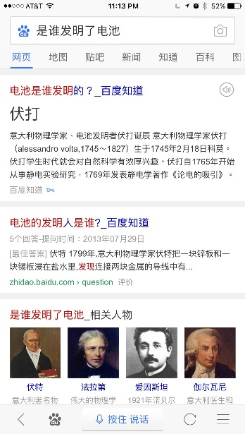

AI revolutionizing our world
Search, Assistants, Translation,
Recommendations, Shopping, Photos…
Detect, Diagnose and Treat Diseases
Powering Breakthroughs in Agriculture, Manufacturing, EDA
Notes:
AI is revolutionizing our world
Intelligent Internet services (search, translation, recommendations)
Healthcare
DL Farming
Arterys, which is bringing deep learning to medical image analysis, earned FDA clearance for its software that provides automated ventricle segmentations from conventional heart MRI scans that are as accurate as manual segmentations performed by physicians, the company announced Monday.
The Arterys Cardio DL software automates time-consuming analyses of cardiac MRI images, generating editable contours showing the inside and outside of the ventricles of the heart. The software processes a scan in 10 seconds, far more quickly than a clinician would. The application uses a deep learning algorithm that was trained using data from several thousand cardiac cases, the company said in a statement. The algorithm produces results comparable to those of an experienced clinical annotator, Arterys said.

Slide 3
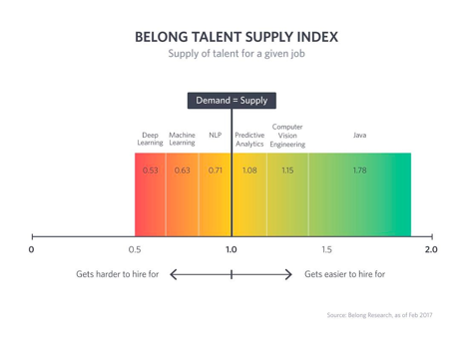
AI-DL skill build: India opportunity
AI/DL talent provider for the World

Slide 4





IBM Offering for Education Institutions
Education Courses bundle with IBM certification
With IBM Career Education
Big Data & Analytics
IoT
Cyber security
AI
Containerized Machine-Deep Learning frameworks
PowerAI
Workload and Application Management
(Easy to build and deploy applications, Easily distribute workloads across clusters, Highly scalable, Multi-tenancy support)
Conductor For Containers (Community Edition)
Differentiated Infrastructure – IBM Power AC 922
(Superior Thread Performance, Compute offload, Large Bandwidth, Accelerators)
(Minimum configuration 2 P9 Sockets,

Slide 5
Value proposition What’s in for You?
Leadership
First amongst peers to start AI/Deep Learning Elective courses
Branding Associated
IBM co-Branded lab at the campus
Joint Press release with IBM
Social media endorsements
Opportunity to certified as “IBM AI Expert” for student
Opportunity for Industry collaboration
Opportunity for selected faculties to visit IBM research labs.
Opportunity for students to showcase their deep learning projects
Opportunity for short term training programs
Opportunity to offer high in demand short term training programs to industry professionals and outside students with the cost.
Student Industry readiness & employability.
Prepare students for challenges and skills required that an AI driven economy and computing model will demand

Slide 6



PowerAI
PowerAI: Open-Source Based Enterprise AI Platform
Offering
Software distribution of open-source AI frameworks
Open-source Enhanced for Ease of Use & Faster AI Training Times
3-4x Faster Training on Power-GPU Servers
Value Proposition
Up & Running in minutes – on Redhat
Integrated & Supported AI Platform
Higher Productivity for Data Scientists
Point-and-Click AI for Ease of Use
Developer Ease-of-Use Tools
Open Source Frameworks:
Supported Distribution
Faster Training Times via
HW & SW Performance Optimizations
GPU-Accelerated Power Servers
Storage
Notes:
The PowerAI strategy is we create an enterprise software distribution of the open source machine learning / deep learning frameworks and add value around them.
We add ease of use tools on top of the frameworks and performance enhancements underneath them.
We monetize primarily with hardware sales, but also will get some software revenue, which will grow our margin from systems.
The ease of tools we add are things that help data scientists do data preparation, manage their models, and the machine learning pipeline. For starters, we are integrating with IBM Data Science Experience (DSX), which is leading data scientist development tool.
For performance, we are releasing a new Distributed Deep Learning (DDL) library that scales out deep learning to 100s of Power servers with GPUs. Currently, the open source AI frameworks work best only on a single server, so this is new technology that came out of IBM Research that will enable training times to go down from weeks and days to hours. Massive improvement in data scientist productivity

Slide 7
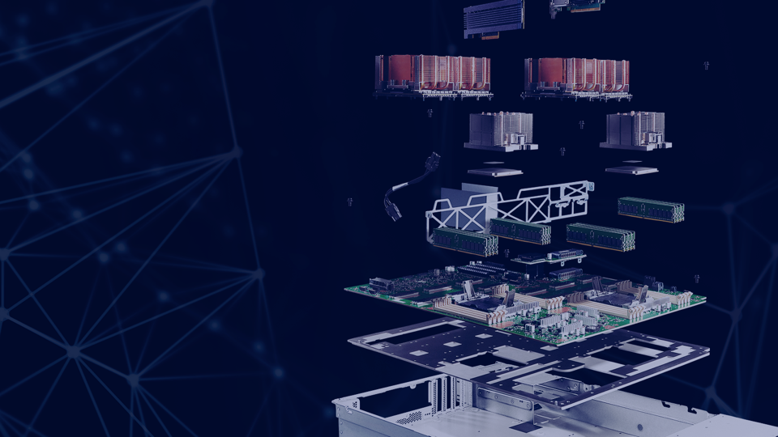



IBM Power Systems
AC922
An acceleration superhighway
Designed for the AI era
4-GPU and 6-GPU Configurations

Slide 8
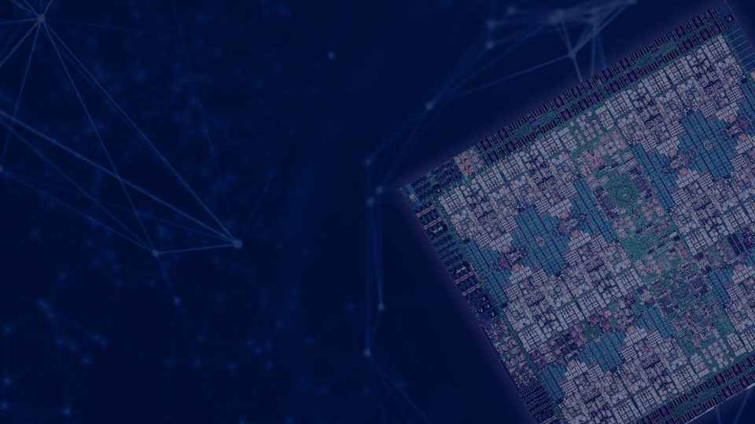
The New POWER9 Processor
Specifically designed for the AI era
2x
6-9.5x
2.6x
1.8x
high performance cores vs x86
CPU to accelerator bandwidth
more RAM
more memory bandwidth
2x
PCI Gen 4
Processor Cache
Ahead of Intel x86
PCI

Slide 9
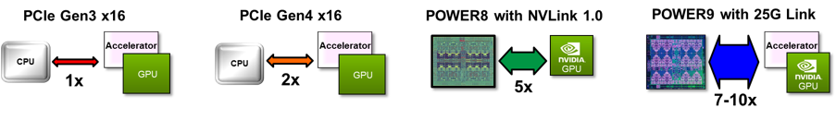
POWER9 – Ideal for acceleration
Only Available with POWER:
Extreme CPU/Accelerator Bandwidth
Today’s Intel Systems: System bottleneck
Increased Performance / Features / Acceleration Opportunity
Seamless CPU/Accelerator Interaction
Coherent memory sharing
Enhanced virtual address translation
Broader Application of Heterogeneous Compute
Designed for efficient programming models
Accelerate complex analytic / cognitive applications
NDA until product announce
Notes:
When we say how are nine is the ideal processor fork celebration you simply have to look at the various Advanced IO interfaces that only available on power. If we set the band with to PCA gentry speeds as one normalize it and compare to the other interfaces we have introduced into the power nine processor for example PCIe gen 4 has double the band width of that PCI E GEN three which X 86 remains committed to. Additionally Power is the only processor with in the wink between the processor and the axcelerator delivering up to 10 times the data bandwidth all while providing a coherent interface.

Slide 10






















Career Education Program : Clients & Recruiters
IBM Career Education

Slide 11









IBM Brings AI to Universities & Research Institutes
Deep Learning for Bio-Informatics
Deep Learning for Medical Image Research
Deep Learning for Material research
Multi-disciplinary research for accelerated computing
Deep Learning for Genomics research
Accelerated computing for Astronomy research
Moscow State University
Multi-node cluster for student education and training
AI research in Genomics
AI research in Genomics

Slide 12
Thank You

